Slide 1

A Study of Attrition Rate Predictors at IBM

Slide 2
Overview of the Process
Development of Business Problem
Exploration of Data Methods
Developing and Testing Models
Review Findings
Introduction to Dataset

Slide 3
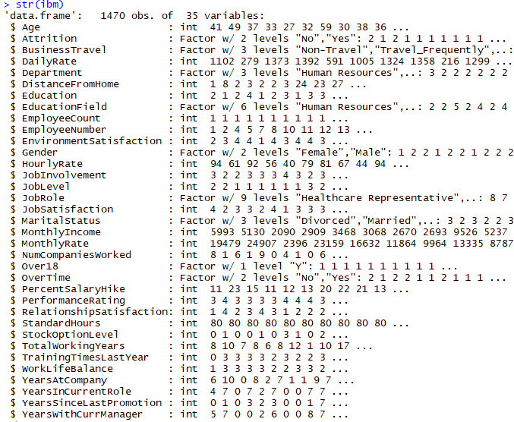
The Dataset
Fictional Dataset Created by IBM Data Scientists
Data types:
Numerical
Categorical variables

Slide 4
Data Dictionary
Education
1 Below College
Job Sat & Relationship Sat
1 Low
2 College
2 Medium
3 Bachelor
3 High
4 Master
5 Doctor
4 Very High
Performance Rating
1 Low
Enviro Satisfaction
1 Low
2 Good
2 Medium
3 Excellent
3 High
4 Out Standing
4 Very High
Work Life Balance
1 Bad
Job Involvement
1 Low
2 Good
2 Medium
3 Better
3 High
4 Best
4 Very High

Slide 5
The Business Problem
Can we predict employee attrition
Null Hypothesis: The employee is not at high risk of attrition/turnover
Pay
Overtime
Business Travel
Attrition

Slide 6
Exploratory Data Analysis
The next few slides show the exploration into several factors of the data that stood out during an initial graphing of the data.

Slide 7
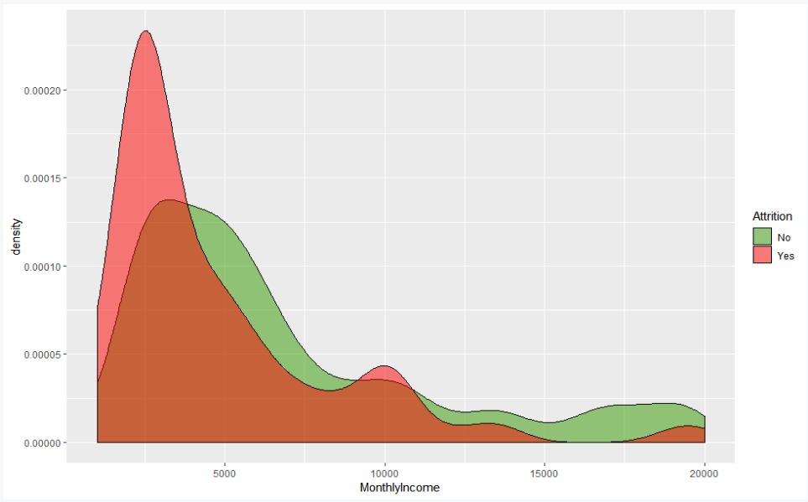
Exploratory Data Analysis
Notes:
Employees attrition rates strongly correlated to monthly income

Slide 8
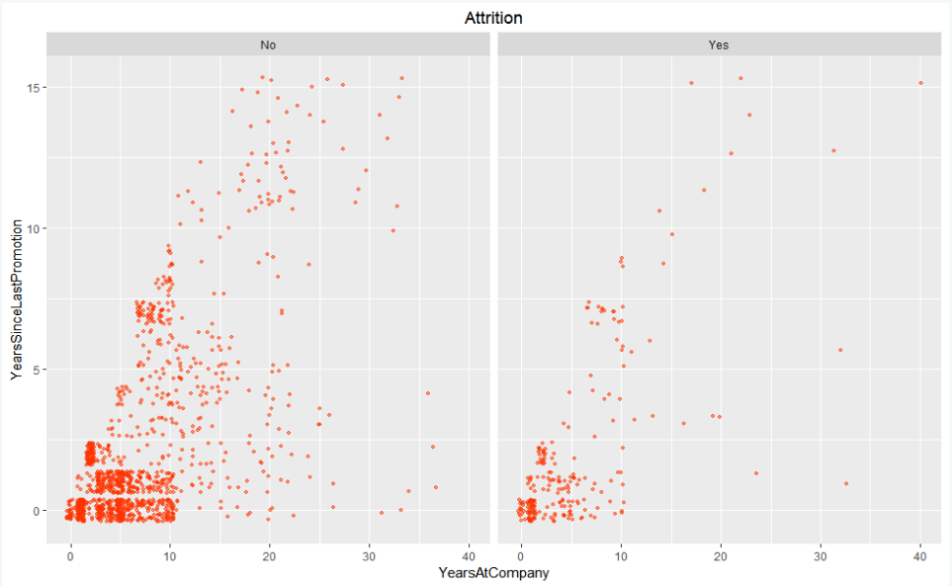
EDA Cont.
Notes:
A strong correlation between promotion timing and years at the company was also found
Those promoted quickly are likely to stay based on the density of the graphs

Slide 9
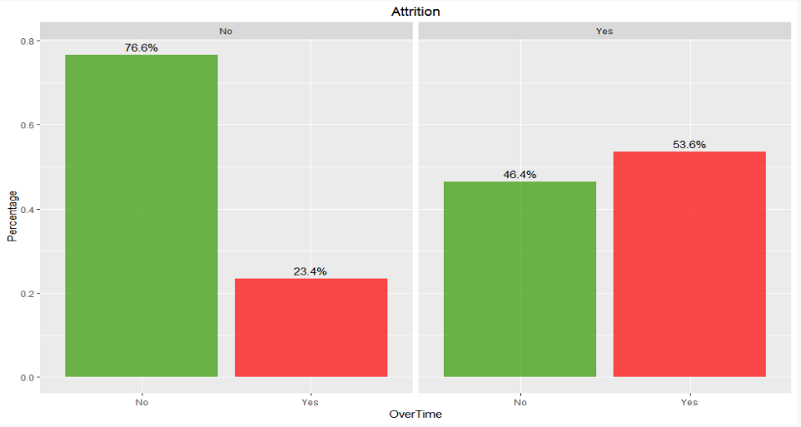
EDA Cont.
Notes:
Employees who worked less overtime had less attrition rates.

Slide 10
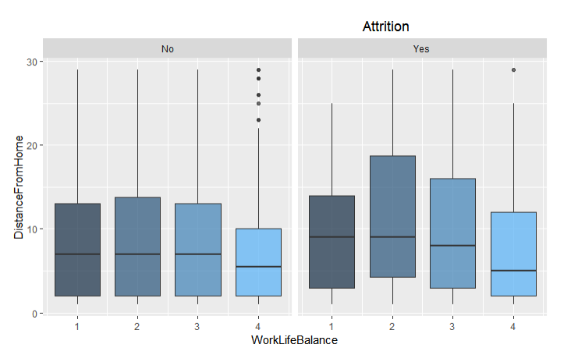
EDA Cont.
Graph indicates a jump in attrition for those who lived farther from work

Slide 11
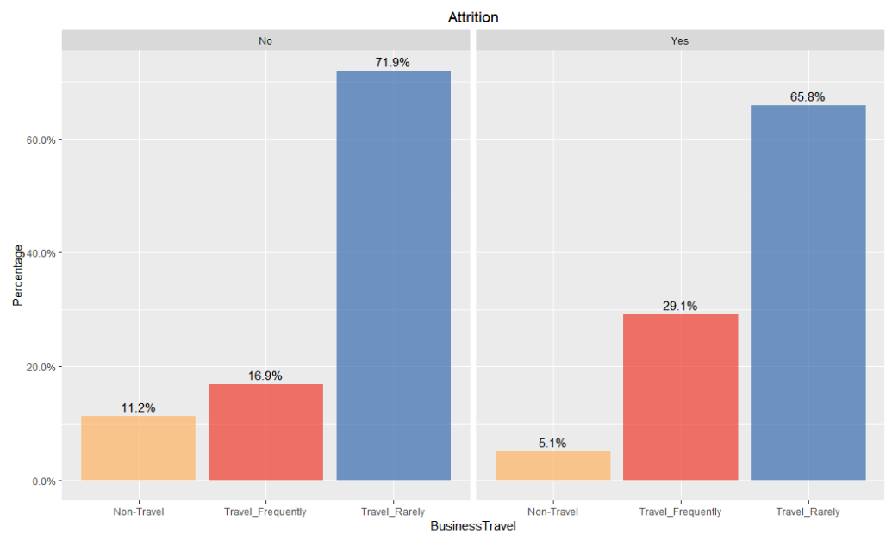
EDA Cont.

Slide 12
Modeling the Data
The data was modeled using four different methods:
Random Forest
LDA
QDA
KNN

Slide 13
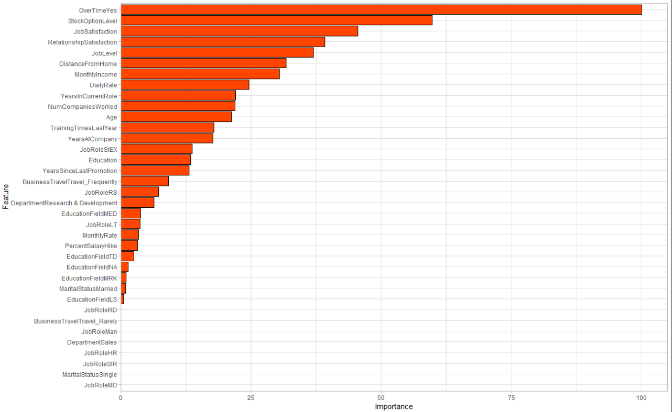
Choosing Variables
Predictors were chosen from a Random Forest Model:
The following variables were chosen as predictors based on an arbitrary threshold

Slide 14
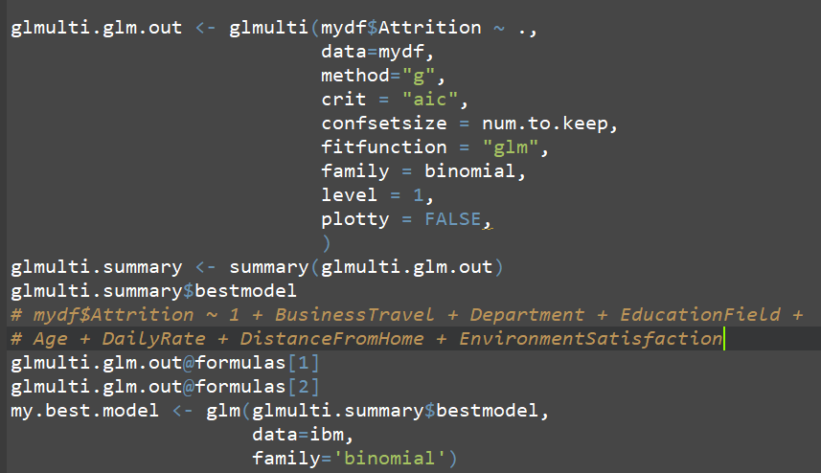
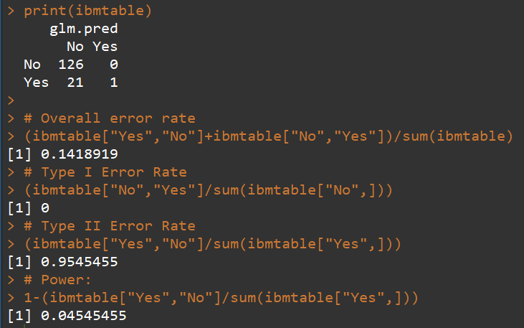
GLMulti
Used the “best-model” to make predictions on the test data set
Model error rates show potential for over sampling

Slide 15
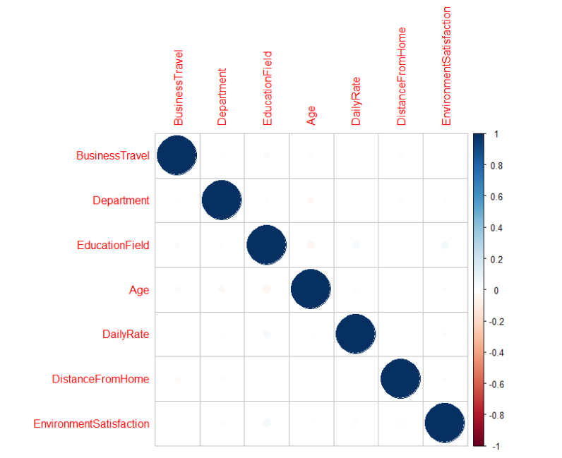
Subset correlation matrix
The correlations between variables are close to zero.
Indicates algorithm has dropped highly correlated variables
the low correlations between variables don’t necessarily mean reliability

Slide 16
Comparing the Models
Set of Variables (Threshold) :
OverTime, StockOptionLevel, WorkLifeBalance, JobSatisfaction, JobLevel, JobInvolvement, EnvironmentSatisfaction, YearsAtCompany,TrainingTimesLastYear, MonthlyIncome, Age
Set of Variables (“Best Model”) :
BusinessTravel, Department, EducationField, Age, DailyRate,DistanceFromHome,EnvironmentSatisfaction
Given the unclear definition of “DailyRate”, though it shows significance in both RandomForest and glmulti, we decided not to involve it in our variables choice

Slide 17
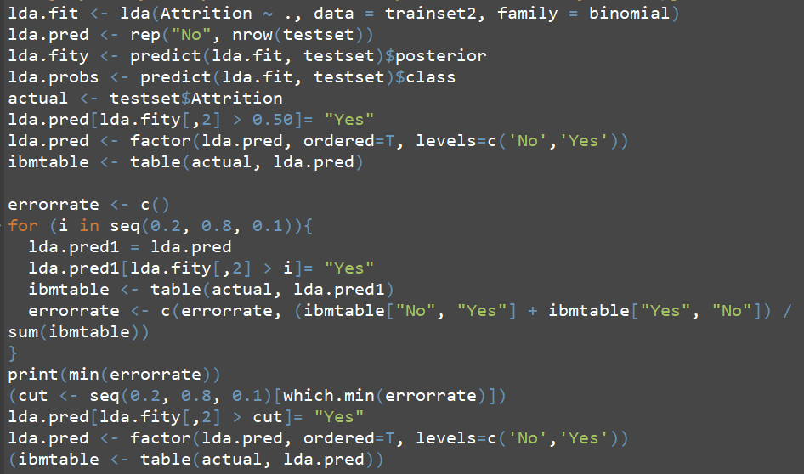
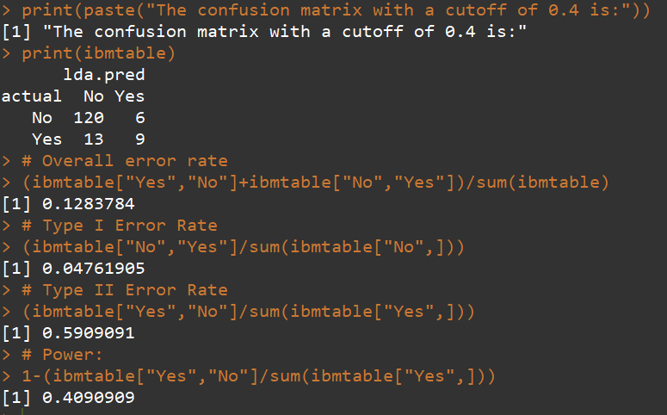
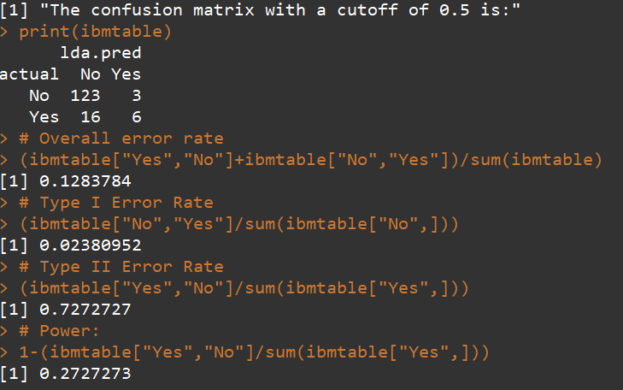
Linear Discriminant Analysis
Changing the cut off from .5 to .4 lead to an improved power of the model
How might changing from .5 to .4 model affect the business decision

Slide 18
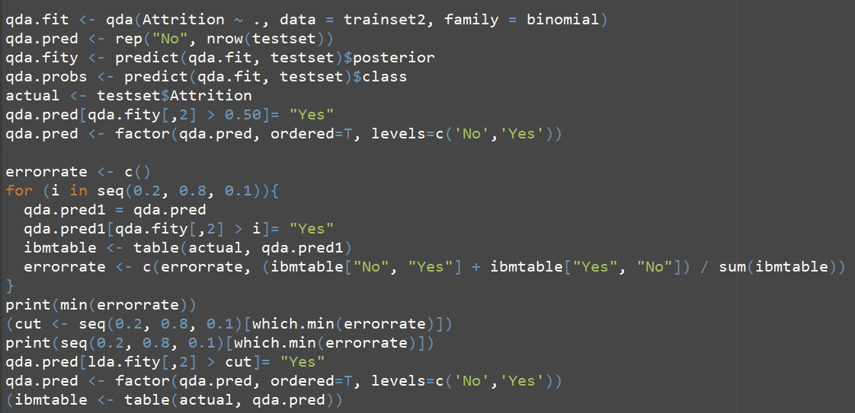
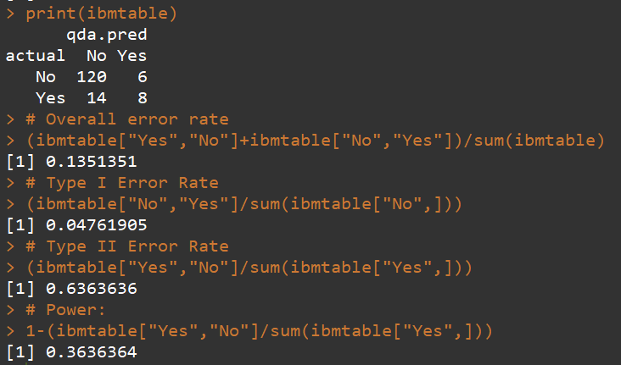
Quadratic Discriminant Analysis
The QDA model performed the worst
0.5 cutoff achieves the lowest overall error rate for QDA

Slide 19
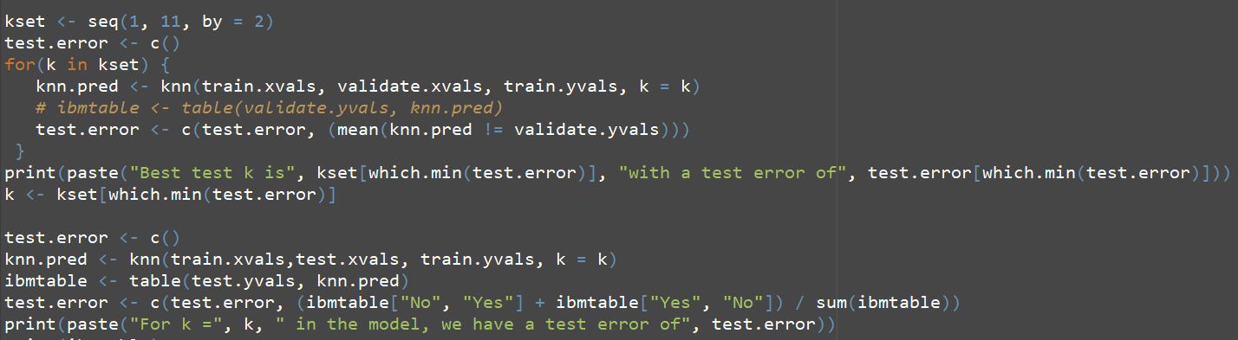
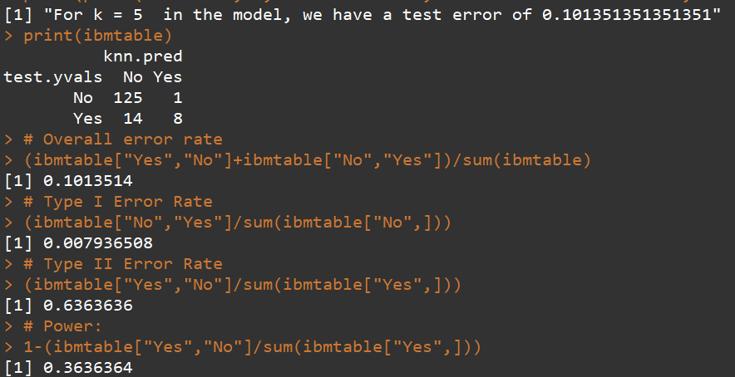
K Nearest Neighbor Analysis
The KNN Model achieved the best overall error rate
Had a relatively high Type II error rate

Slide 20
Comparing the Models: Overall Error Rate
Variables Sets Models | Set of Variables (Threshold) : | Set of Variables (“Best Model”) :
GLM | --- | 0.1419
KNN | 0.1014 | 0.1622
LDA | 0.1284 | 0.1486
QDA | 0.1351 | 0.2162
RandomForest (SMOTE) | 0.1419

Slide 21
Comparing the Models: Overall Power
Variables Sets Models | Set of Variables (Threshold) : | Set of Variables (“Best Model”) :
GLM | --- | 0.0454
KNN | 0.3636 | 0.0454
LDA | 0.4091 | 0.0454
QDA | 0.4545 | 0.2162
RandomForest (SMOTE) | 0.5455

Slide 22
Ultimate Model Selection
It depends!
Trade-offs:
Estimating costs of hiring vs retention packages (more data)
Equip model with simulation and optimization- tune parameters
Higher Power
More False Positives
Time and Money Spent
Lower Power
More Employee Attrition
Time and Money Spent

Slide 23

Other Business Concerns
Adjusting hiring and/or cultural structure
Conversations: interpreting HR data vs Real People
Firing vs Attrition: Business Reputation and Culture

Slide 24
Implementation Schema
Present results to management and HR (KNN-Threshold?)
Work with HR to nuance results, collect more info/data
Construct compact learning/optimization model
Run on schedule with employees to predict attrition
Design appropriate package or terminate
Annual/Semi-annual review

Slide 25
Back up Slides

Slide 26
Subsetting Variables: RandomForest
Predictors were chosen from a Random Forest Model: Pick the boosted RF Model and plot an graphic of the importances among each predictor
The predictors we picked according to the importance chart: "OverTime","StockOptionLevel","WorkLifeBalance","JobSatisfaction","JobLevel","JobInvolvement",“RelationshipSatisfaction","YearsAtCompany","TrainingTimesLastYear","MonthlyIncome", "Age“, “DailyRate", “YearsinCurrentRole“,“NumCompaniesWorked“,”DistanceFromHome”

Slide 27
Subsetting Variables: GLMulti
Using the “best-model” to make predictions on the test data set, we found that the model is doing perfectly on avoiding the Type I error while making a lot of Type II errors. ( This is probably due to the over-sampling of the data)

Slide 28
Visualize the correlation matrix of the subset
The result is quite satisfying. The correlations between each two of the variables are close to zero.
Although for a binary classification problem, the low correlations between variables don’t help a lot to the reliability, it at least indicates that the algorithm has already dropped variables which are highly correlated with each other if they exist.

Slide 29
Comparing the Models
Set of Variables (Team Theta) :
"OverTime","StockOptionLevel","WorkLifeBalance","JobSatisfaction", "JobLevel","JobInvolvement",“EnvironmentSatisfaction", "YearsAtCompany", TrainingTimesLastYear","MonthlyIncome", "Age“
Set of Variables (“Best Model”) :
"BusinessTravel","Department", "EducationField",
"Age","DailyRate","DistanceFromHome","EnvironmentSatisfaction"
Given the unclear definition of “DailyRate”, though it shows significance in both RandomForest and glmulti, we decided not to involve it in our variables choice

Slide 30
Comparing the Models
Variables Sets Models | Set of Variables (Team Theta) : | Set of Variables (“Best Model”) :
GLM | --- | 0.1419
KNN | 0.1014 | 0.1622
LDA | 0.1284 | 0.1486
QDA | 0.1351 | 0.2162
RandomForest(SMOTE) | 0.1419

Slide 31
Linear Discriminant Analysis
By changing the cut off from 0.5 to 0 .4, we can improve the Type II error rate for the LDA model but get a slightly higher Type I error in return.

Slide 32
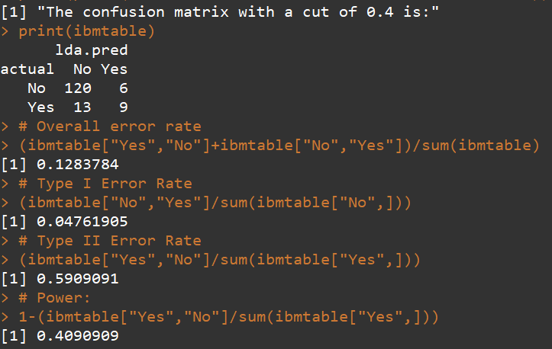
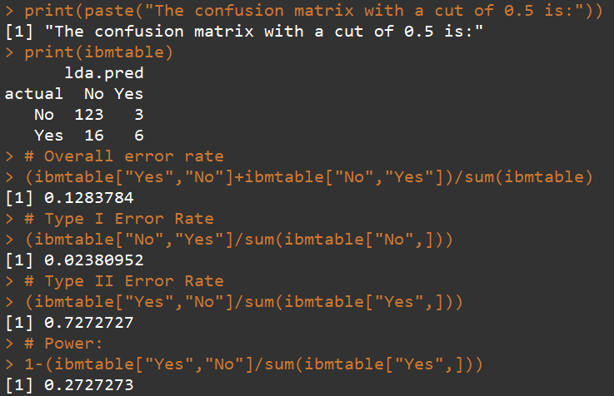
Linear Discriminant Analysis
Although the approach will increase the predicting power of the model, from a business standpoint, we should also consider the potential cost it will bring to the company

Slide 33
Quadratic Discriminant Analysis
The QDA model performed the worst in overall error rate and still not good in Type II errors
0.5 cutoff achieves the lowest overall error rate for QDA

Slide 34
K Nearest Neighbor Analysis
The KNN Model achieved the best result so far regarding to overall error rate, but with a relatively high Type II error rate

